Slide 1


Multiclass Retinal Image Classification for Diabetic Retinopathy Stages Using Convolutional Neural Networks

Slide 2
Contents
Abstract
Introduction with motivation
Existing System with references
Proposed System with advantages
Software Requirements
Hardware Requirements
Functional Requirements
Non Functional Requirements
System Architecture
System Design
Output Screens
System Modules
Conclusion
Future Scope
2

Slide 3
ABSTRACT
Diabetic Retinopathy (DR) is a leading cause of blindness, and its early detection is crucial for effective treatment. This project focuses on developing a robust, deep learning-based model for multiclass retinal image classification to identify different stages of diabetic retinopathy using Convolutional Neural Networks (CNNs). The model is trained on a dataset of retinal images, each labeled according to the severity of DR, ranging from mild to severe stages. The images undergo preprocessing, including resizing, normalization, and augmentation, to improve the model’s generalization ability. A CNN architecture, potentially leveraging transfer learning techniques with pre-trained models like ResNet or DenseNet, is utilized for accurate feature extraction and classification. The model's performance is evaluated using metrics such as accuracy, precision, recall, and F1-score, with the goal of achieving high classification accuracy across multiple stages of DR. This work aims to provide an efficient and automated solution for early detection of diabetic retinopathy, facilitating timely medical intervention and reducing the burden on healthcare professionals.
3

Slide 4
INTRODUCTION
Diabetic Retinopathy (DR) is a common complication of diabetes that affects the eyes, leading to potential vision loss or blindness if left untreated. It occurs due to damage to the blood vessels in the retina, which can result in bleeding, leakage, or the growth of abnormal blood vessels. As the disease progresses, it can lead to varying stages of retinopathy, ranging from mild non-proliferative DR to severe proliferative DR, with the latter causing significant vision impairment. Early detection and diagnosis are critical for preventing irreversible damage to the retina and ensuring timely treatment.
In clinical practice, the diagnosis of diabetic retinopathy is typically carried out by ophthalmologists through a process called retinal screening, which involves the examination of retinal images. However, manual analysis of these images is a time-consuming and subjective process, heavily dependent on the expertise of the clinician. This creates a need for automated diagnostic systems that can quickly and accurately assess the severity of DR from retinal images.
4

Slide 5
INTRODUCTION
With advancements in deep learning and computer vision, Convolutional Neural Networks (CNNs) have emerged as a powerful tool for image classification tasks, including medical image analysis. CNNs are particularly well-suited for handling visual data, as they automatically learn and extract relevant features from images. This capability has made them highly effective for tasks like identifying patterns in retinal images and classifying them based on various stages of diabetic retinopathy.
The goal of this project is to develop a deep learning model that can automatically classify retinal images into different stages of diabetic retinopathy, leveraging CNNs. The model will be trained on a labeled dataset of retinal images, where each image is categorized based on the severity of DR, ranging from mild to severe stages. By using CNNs, the model will learn the intricate patterns and features in retinal images that are indicative of DR stages, providing an efficient and automated solution for diagnosis.
4

Slide 6
Existing Systems and Their Disadvantages
Several existing systems aim to assist in the detection of diabetic retinopathy through automated image classification techniques, but many of them face limitations in terms of accuracy, scalability, and adaptability. These systems generally rely on traditional image processing methods, machine learning algorithms, or shallow neural networks. While they have shown promise, they still struggle with several key challenges:
Traditional Image Processing: Some systems use hand-crafted features like texture, color, or shape extracted from retinal images for classification. However, these methods often miss subtle features that could indicate early-stage diabetic retinopathy, leading to false negatives or poor performance in complex cases. Additionally, these methods are often time-consuming and require domain expertise for feature extraction.
Shallow Machine Learning Models: Many early attempts at automated DR detection used shallow machine learning models such as Support Vector Machines (SVM) or decision trees. These models rely on manually designed features and often require a large amount of preprocessing to achieve good performance. However, they are limited by their inability to learn deep hierarchical features directly from the raw image data, which restricts their ability to adapt to new, unseen patterns in retinal images.
5

Slide 7
Existing Systems and Their Disadvantages
Deep Learning Models with Limited Data: While Convolutional Neural Networks (CNNs) have been successfully applied to medical image classification, many existing systems use small datasets or suffer from overfitting due to insufficient data. This reduces the model's ability to generalize well to new cases, leading to lower accuracy and reliability when deployed in real-world settings.
Class Imbalance: In many existing systems, the datasets used for training often suffer from class imbalance, where certain stages of diabetic retinopathy are underrepresented. This can result in biased models that perform well on more prevalent classes but poorly on underrepresented ones, leading to misclassification of less common stages of DR.
Lack of Interpretability: Many deep learning models, especially those applied to medical imaging, are considered "black boxes," offering little insight into the decision-making process. This lack of interpretability can be a significant drawback in medical applications, where understanding how a decision was made is crucial for building trust with healthcare professionals.
5

Slide 8
PROPOSED SYSTEM
The proposed system aims to overcome the limitations of existing methods by leveraging advanced deep learning techniques, particularly Convolutional Neural Networks (CNNs), for the automated classification of diabetic retinopathy (DR) stages from retinal images. Unlike traditional image processing methods, which rely on manual feature extraction, or shallow machine learning models, which cannot learn complex hierarchical features, the proposed system will be capable of directly learning these features from raw image data, significantly improving its accuracy and generalization.
Key features of the proposed system include:
Deep Learning with CNNs: The core of the system is a CNN, which is trained on a large dataset of retinal images. This architecture will enable the system to automatically learn both low-level and high-level features from the images, allowing for better recognition of the intricate patterns associated with different stages of diabetic retinopathy. The system will be built using state-of-the-art CNN models such as ResNet, DenseNet, or custom architectures to optimize performance.
6

Slide 9
PROPOSED SYSTEM
Data Augmentation and Transfer Learning: To improve the model's ability to generalize and handle limited data, the proposed system will use data augmentation techniques, such as random rotations, flips, and zooms, to artificially increase the size of the dataset. Additionally, transfer learning will be employed, utilizing pre-trained models on large image datasets like ImageNet to fine-tune the model for the specific task of DR classification. This will help overcome the issue of overfitting and improve performance, especially in cases with insufficient labeled data.
Multiclass Classification: The system will classify retinal images into multiple stages of diabetic retinopathy, ranging from mild to severe stages. This multiclass approach will provide a more detailed and accurate diagnosis compared to binary classification methods, helping healthcare professionals understand the severity of the condition and make informed treatment decisions.
Handling Class Imbalance: To address the challenge of class imbalance, the proposed system will implement techniques like class weighting, oversampling, or using focal loss, which will help improve performance on underrepresented classes. This will ensure that the system provides accurate predictions even for less common stages of DR.
6

Slide 10
PROPOSED SYSTEM ADVANTAGES
High Accuracy: The use of deep learning, particularly CNNs, enables the model to learn complex patterns and features, leading to improved accuracy in classifying DR stages.
Adaptability: The system's ability to leverage transfer learning and handle diverse datasets ensures that it can be applied to various populations and medical settings.
Explainability: The inclusion of interpretability techniques enhances transparency, enabling clinicians to understand how the model arrives at its predictions.
Scalability: The system can be deployed in various healthcare settings, from hospitals to remote clinics, making it an effective tool for large-scale diabetic retinopathy screening.
7

Slide 11
SOFTWARE REQUIREMENTS
Operating System: Windows 10/11, Linux (Ubuntu), or macOS.
Programming Language: Python (3.x).
Deep Learning Frameworks:
TensorFlow or Keras (for CNN model development and training).
PyTorch (optional, as an alternative framework).
Libraries:
NumPy (for numerical computations).
OpenCV (for image preprocessing).
Matplotlib/Seaborn (for data visualization).
Scikit-learn (for performance evaluation and metrics).
Data Processing Tools:
Pandas (for data manipulation and analysis).
Integrated Development Environment (IDE):
Visual Studio Code, PyCharm, or Jupyter Notebook.
8

Slide 12
SOFTWARE REQUIREMENTS
Visualization Tools:
Matplotlib: For visualizing data and model performance.
Seaborn: For enhanced statistical visualizations.
Plotly: For creating interactive and dynamic plots.
Deployment Tools (Optional for Real-Time Monitoring):
Flask or FastAPI: For deploying the model as a web service.
Docker: For containerizing the application.
Streamlit: For building a simple web-based user interface for real-time monitoring.
8

Slide 13
HARDWARE REQUIREMENTS
Processor:
Minimum: Intel Core i5 (8th Gen or higher) or AMD Ryzen 5.
Recommended: Intel Core i7/i9 (10th Gen or higher) or AMD Ryzen 7/9 for better performance during training.
Graphics Processing Unit (GPU):
Minimum: NVIDIA GTX 1050 or equivalent (for small-scale training).
Recommended: NVIDIA RTX 3060/3070/3090 or higher, or NVIDIA A100 (for faster deep learning model training).
RAM:
Minimum: 8 GB (sufficient for small datasets and basic development).
Recommended: 16 GB.
Storage:
Minimum: 256 GB SSD (Solid State Drive) for system and software.
Recommended: 512 GB or 1 TB SSD to accommodate datasets, checkpoints, and model files.
Hard Drive (Optional for Data Backup):
Additional HDD (1 TB or more) for storing backup datasets and processed results.
9

Slide 14

Functional Requirements:
Image Preprocessing:
The system should be able to load and preprocess retinal images for training and testing.
It should handle operations such as resizing, normalization, and data augmentation (rotation, flipping, zooming).
Model Training:
The system should support the training of a Convolutional Neural Network (CNN) model on a labeled dataset of retinal images.
It should allow for the use of transfer learning, utilizing pre-trained models for fine-tuning.
Multiclass Classification:
The system should classify retinal images into multiple stages of diabetic retinopathy (mild, moderate, severe, etc.).
It should output a classification label indicating the severity of DR.
Model Evaluation:
The system should evaluate the trained model using metrics like accuracy, precision, recall, and F1-score.
It should provide a confusion matrix and other relevant performance statistics.
Class Imbalance Handling:
The system should implement techniques (e.g., class weighting, oversampling) to address class imbalance during training.
Real-time Inference:
The system should allow real-time inference, enabling users to input new retinal images and receive immediate classification results.

Slide 15
Non-Functional Requirements
Performance:
The system should be capable of processing and classifying retinal images efficiently, with training times optimized through the use of GPUs.
Inference (image classification) should be completed within a few seconds per image to ensure fast results.
Scalability:
The system should be able to scale to handle a large number of images and datasets without a significant drop in performance.
It should support batch processing for large-scale image classification tasks.
Reliability:
The system must be stable and able to handle errors gracefully, ensuring that crashes or unexpected failures are minimized.
It should provide clear error messages for users in case of input errors or processing failures.
Usability:
The system should have an intuitive user interface that is easy to navigate, whether for uploading images or viewing results.
It should require minimal training for healthcare professionals or users to operate.
Maintainability:
The system should be designed in a modular way so that individual components (such as the model or preprocessing steps) can be easily updated or replaced.
Code should be well-documented for future modifications or debugging.

Slide 16
UML DIAGRAMS

Slide 17
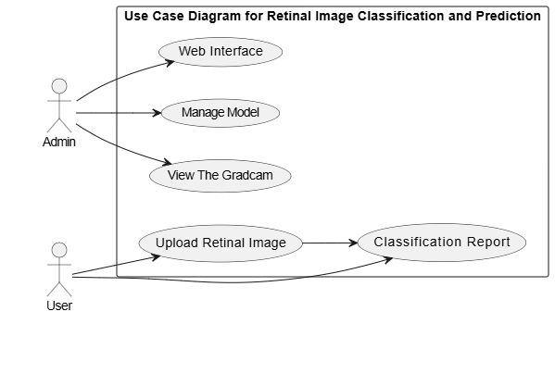
USE CASE DIAGRAM:

Slide 18
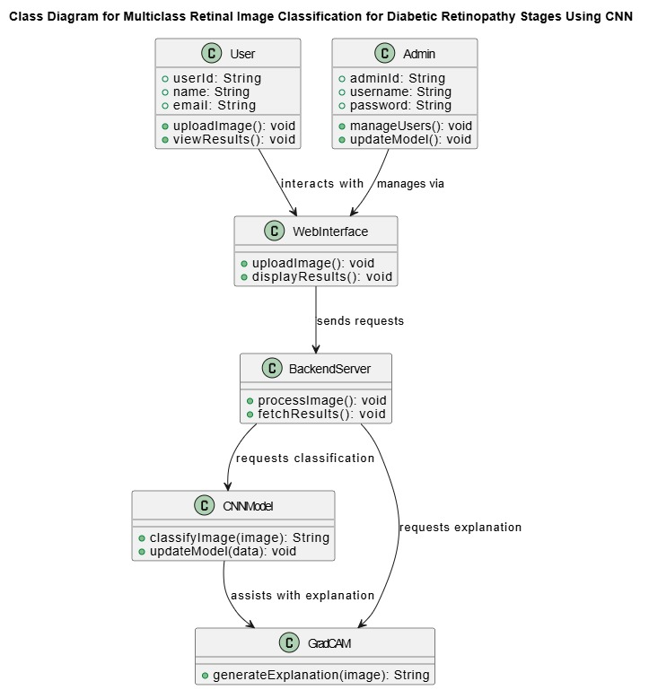
CLASS DIAGRAM:

Slide 19
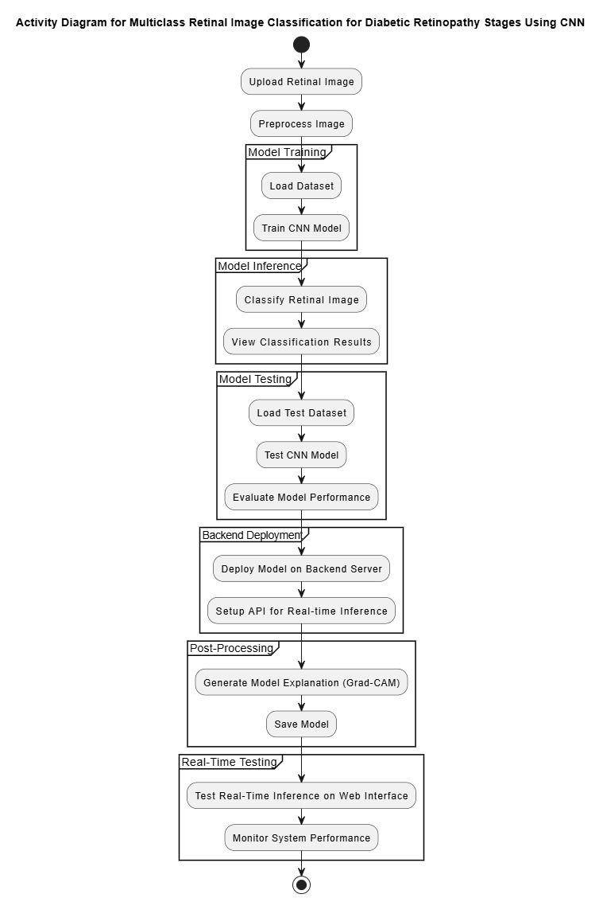
ACTIVITY DIAGRAM:

Slide 20
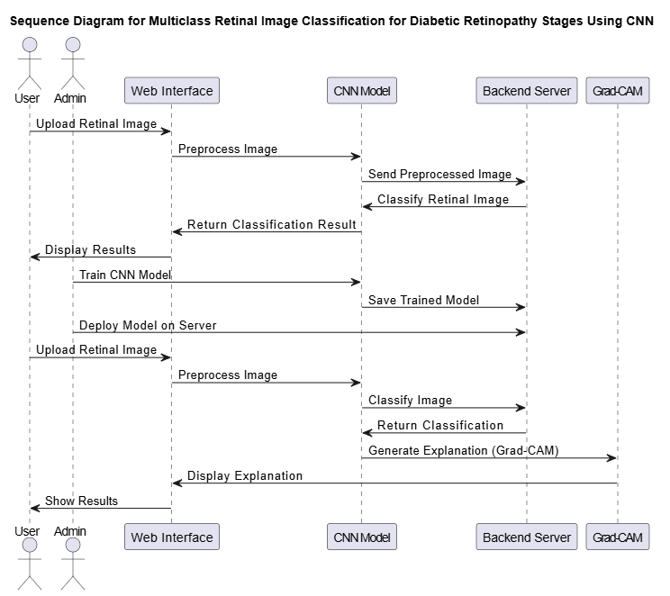
SEQUENCE DIAGRAM:
15

Slide 21
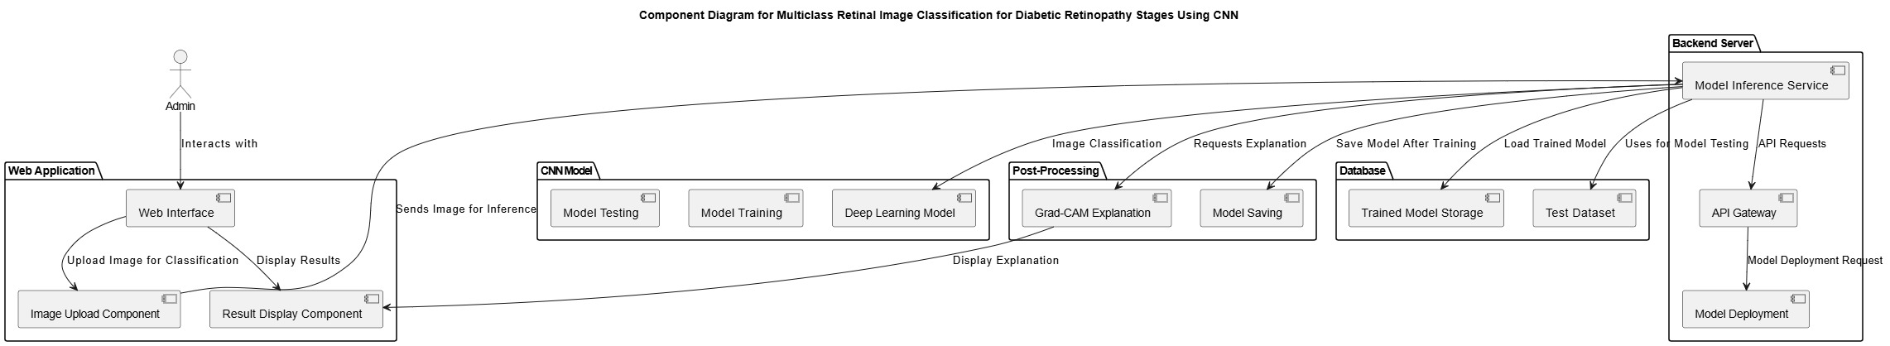
COMPONENT DIAGRAM:
16

Slide 22
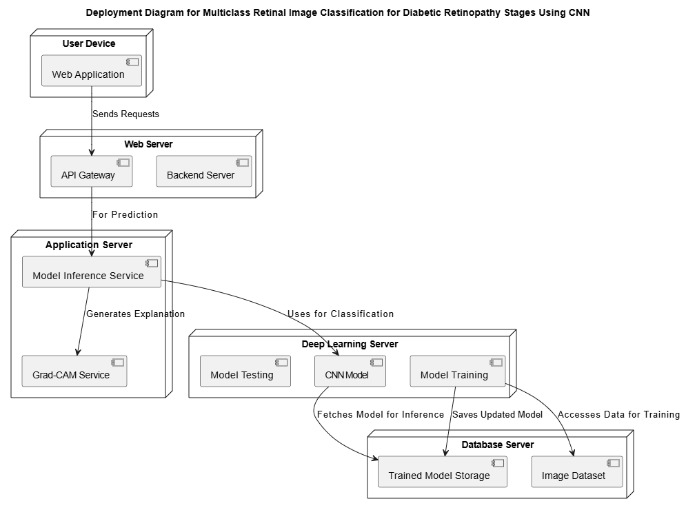
DEPLOYMENT DIAGRAM:
17

Slide 23

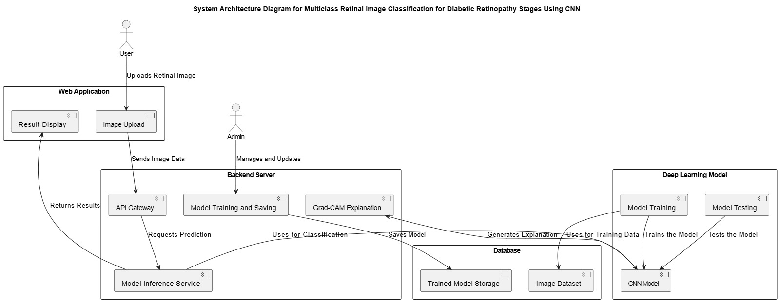
SYSTEM ARCHITECTURE

Slide 24
MODULES
For the Multiclass Retinal Image Classification for Diabetic Retinopathy Stages Using CNN project, the system can be divided into several modules. Each module plays a critical role in the overall functionality of the system.
Here are the main modules for your project:
1. Image Upload Module
Purpose: This module allows users (healthcare professionals or admins) to upload retinal images for classification.
Components:
Image Upload Interface: Provides the user interface for image selection and uploading.
Preprocessing: Handles image resizing, normalization, and other preprocessing tasks before sending the image for classification.
2. Model Inference Module
Purpose: Handles the core image classification process using the trained CNN model.
Components:
Model Loading: Loads the pretrained deep learning model for classification.
Image Classification: Passes the uploaded retinal image through the CNN model to classify the stage of diabetic retinopathy.
API Gateway: Facilitates communication between different backend services and the web frontend.
18

Slide 25
3. Post-Processing Module
Purpose: This module handles post-processing tasks such as generating explanations for the classification.
Components:
Grad-CAM: A visualization technique to provide a heatmap explaining which parts of the retinal image contributed most to the classification result.
Model Saving: Saves the trained model for future use, retraining, or deployment.
4. Result Display Module
Purpose: Displays the classification results and any relevant explanations (e.g., Grad-CAM).
Components:
Results Interface: Shows the predicted diabetic retinopathy stage (e.g., No DR, Mild DR, Moderate DR, Severe DR).
Explanation Interface: Displays the Grad-CAM heatmap overlay on the image to help healthcare professionals understand the model's decision-making process.
5. Model Training and Testing Module
Purpose: Trains and tests the CNN model using labeled retinal image datasets.
Components:
Model Training: Involves training the model with labeled data to learn the stages of diabetic retinopathy.
Model Testing: Evaluates the trained model's performance using a test dataset to check its accuracy and generalization.
19

Slide 26
6. Database Module
Purpose: Handles the storage and retrieval of data, including the trained models and test datasets.
Components:
Trained Model Storage: Stores the final trained CNN model.
Test Dataset: Stores the dataset used for testing the trained model.
7. User Management and Access Control Module
Purpose: Manages user roles (e.g., Admin, Healthcare Professional, User) and their respective access to features in the application.
Components:
Authentication: Ensures that only authorized users can upload images and view results.
Authorization: Assigns different access levels for various users (e.g., admin users can retrain models, healthcare professionals can only upload and view results).
19

Slide 27
CONCLUSION
The Multiclass Retinal Image Classification for Diabetic Retinopathy Stages Using CNN project presents a powerful solution to assist healthcare professionals in diagnosing diabetic retinopathy stages from retinal images. By leveraging advanced deep learning techniques, particularly Convolutional Neural Networks (CNN), the system automates the process of classification, enabling faster and more accurate diagnosis.
Through the integration of various modules—image upload, model inference, post-processing, result display, and database management—the system offers a seamless experience for users, ensuring the easy uploading of retinal images, accurate classification of diabetic retinopathy stages, and visual explanations through Grad-CAM. Additionally, the inclusion of model training and testing ensures the continuous improvement of the model's performance over time.
The system’s architecture is designed to be scalable and user-friendly, providing robust backend support, efficient data management, and secure user access controls. By reducing the reliance on manual diagnosis, the proposed system has the potential to significantly enhance the accuracy and efficiency of diabetic retinopathy detection, ultimately contributing to better patient outcomes and improved healthcare delivery.

Slide 28
FUTURE SCOPE
Points
Real-Time Diagnosis:
Optimizing the system for real-time retinal image classification, allowing healthcare professionals to make instant decisions, particularly in urgent cases.
Mobile Application Development:
Developing a mobile version of the system to make it accessible to healthcare professionals in remote areas, enhancing its reach and usability.
Enhanced Model Accuracy with Larger Datasets:
Improving the CNN model by using more extensive and diverse datasets, along with advanced techniques like transfer learning, to boost classification accuracy.

Slide 29
REFERENCES
[1]Classification of Diabetic Retinopathy Images by Using Deep Learning Models 1 Suvajit Dutta, Bonthala CS Manideep, Syed Muzamil Basha, Ronnie D. Caytiles1 and N. Ch. S. N. Iyengar2
[2] Gulshan, V., Peng, L., Coram, M., Stumpe, M. C., Wu, D., Narayanaswamy, A., ... & Patel, B. N. (2016). Development and Validation of a Deep Learning Algorithm for Detection of Diabetic Retinopathy in Retinal Fundus Photographs. JAMA, 316(22), 2402-2410.

Slide 30

23

